Slide 1
Miami Carol City Senior High School Opening of Schools Official Daily School Attendance and Gradebook
2
0
0
8
~
2
0
0
9

Slide 2
The Teacher’s Role
Take attendance daily via the electronic grade book (GB) for all periods.
Make sure attendance is submitted by 8:30AM.
Click no shows in GB.
Log all absences and tardies in the GB accordingly. (Second Day-until)
Check the daily attendance report everyday and submit names of students that have discrepancies by e-mailing Mr. Roberts aroberts@dadeschools.net

Slide 3
Key points on Attendance Rules
6Gx13- 5A-1.041
Accumulated unexcused tardies will be counted towards the threshold for initiating attendance review
3 day rule: Students only have 3 days to turn in note to school and complete the make-up assignments for classes missed (within three days of the return to school.)
Students with excessive unexcused absences (5 semester and 10 in annual courses) will automatically have credit withheld.

Slide 4
No shows and new students
No show lists will be emailed, please follow your opening of schools manual carefully, we must be 100% sure of no shows.
Take attendance via the GB daily.
Enter the NS code for all no shows, if student shows up at anytime during the class please change the code accordingly.
Continue through Friday, August 22, 2008.
Make sure to check the attendance bulletin to verify
that students are no shows and not just absent.
For new students to your class, please enter ENT to
indicate that the student has entered your class (you do not have to enter ENT the first day of the class.)

Slide 5
Tardies
3rd tardy to school: Administrative detention
to be served at 6:30 AM.
5th tardy to school: Referral, meeting with
parents, and consideration for return to home
school
We need your help in being out in the hallways
before and after school and between classes

Slide 6
Attendance Review Committee
Conducted by the Administrative Staff
Students that need to make-up hours will be assigned activities throughout the year.
Admits
Admits will be administered before school (7-7:20AM) in attendance office.
Students MUST submit all notes by 3 days upon their return to school; the school may not make changes after 3 days.

Slide 7
Attendance Codes
Code | Description | Attendance Weight | Who can enter this code?
A | Excused Absence | 1 | All Teachers / Attendance Manager
A2 | Excused Absence – Block Schedule | 2 | All Teachers / Attendance Manager
U | Unexcused Absence | 1 | All Teachers / Attendance Manager
U2 | Unexcused Absence – Block Schedule | 2 | All Teachers / Attendance Manager
T | Excused Tardy | 1 | All Teachers / Attendance Manager
T2 | Excused Tardy – Block Schedule (Split Lunch) | 2 | All Teachers / Attendance Manager
TU | Unexcused Tardy | 1 | All Teachers / Attendance Manager
TU2 | Unexcused Tardy – Block Schedule (Split Lunch) | 2 | All Teachers / Attendance Manager
ENT | Entered Class | 0 | All Teachers / Attendance Manager
WD | Withdrawn from Class | 0 | All Teachers / Attendance Manager
NS | No Show | 0 | All Teachers / Attendance Manager

Slide 8
Gradebook

Slide 9
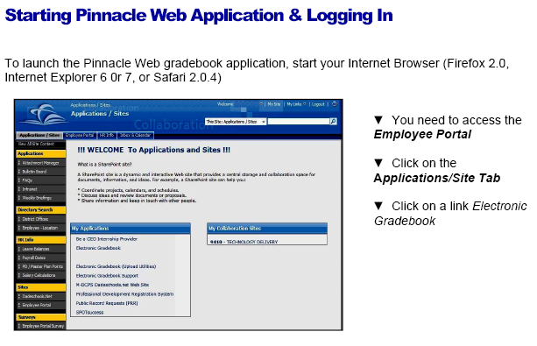
to access portal: http://www2.dadeschools.net/employees/employees.htm then click on the red button

Slide 10
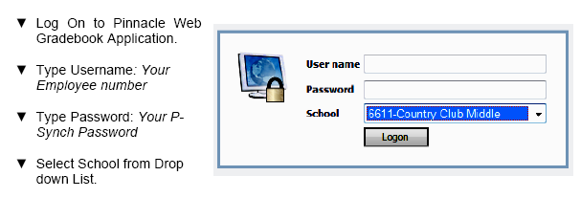
7391 Miami Lakes Educational Center

Slide 12
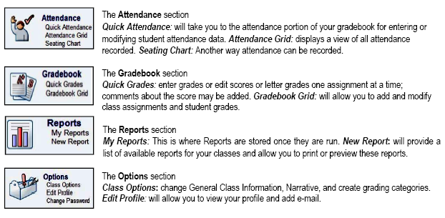

Slide 13
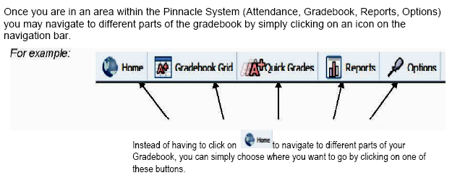

Slide 14
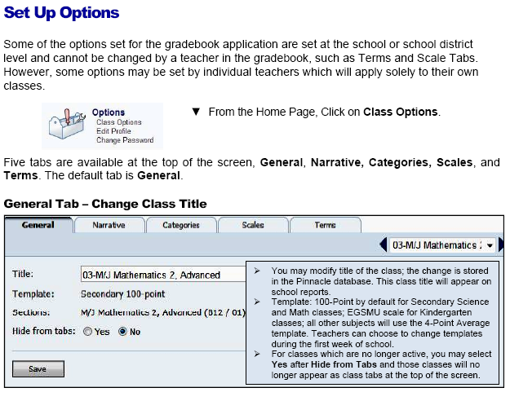

Slide 15
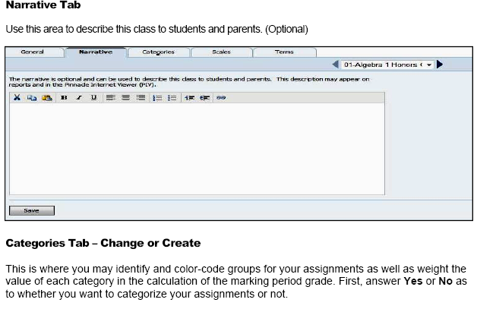
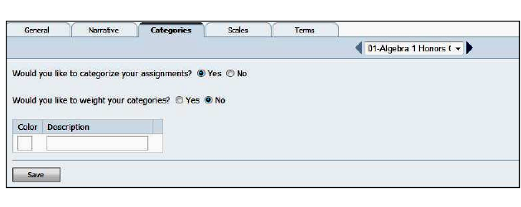

Slide 16
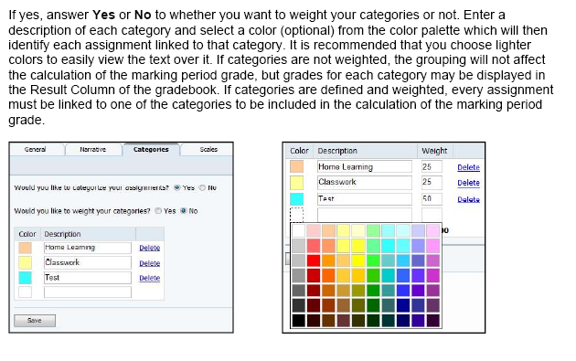

Slide 18
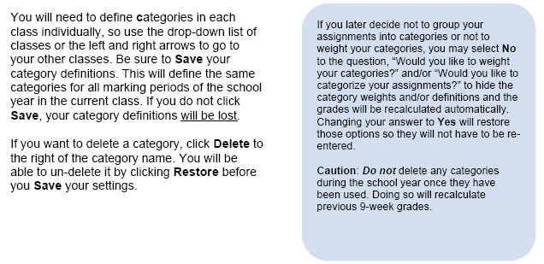

Slide 19
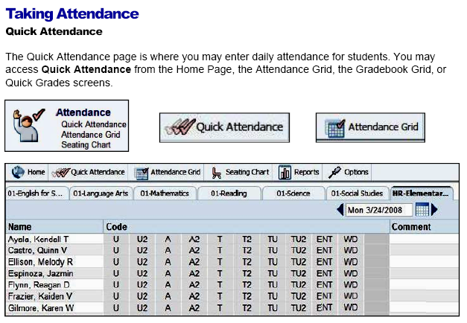

Slide 20
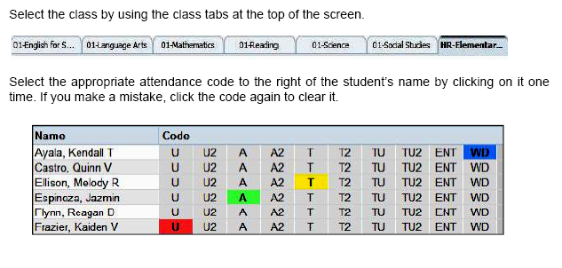

Slide 21
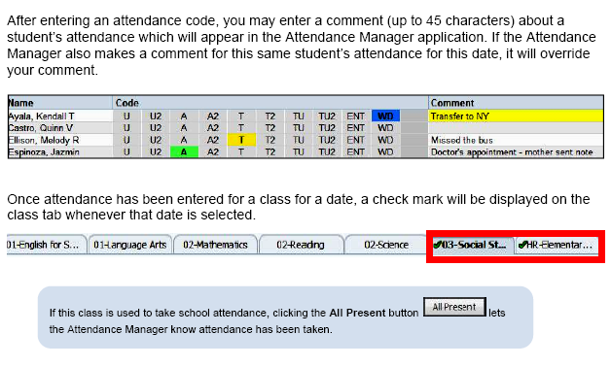

Slide 22
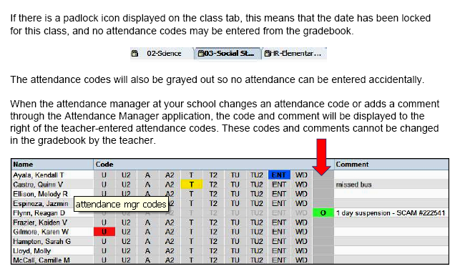

Slide 23
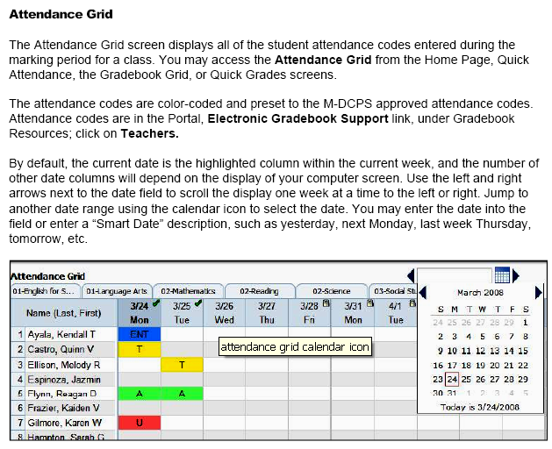

Slide 25
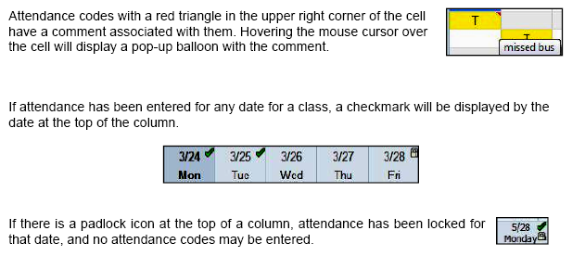
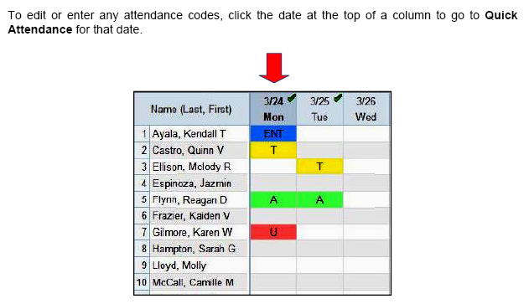

Slide 26
Other Important Information
More information may be found at: http://www2.dadeschools.net/schoolboard/rules/Chapt5/5a-1.041.pdf
Please log into the grade book today and make
sure you have access.
The gradebook manual may be found at http://gradebooksupport.dadeschools.net/pdf/TeacherReference-PinnWeb.pdf
Please go to http://mlec.dadeschools.net and make sure your phone extension is correct.
Please see Mr. Wood for additional help with the gradebook and to learn how to archive your e-mail.

